Slide 1

Exploratory Data Analysis
G2M insight for Cab Investment firm
21 November 2024
Devin Chau
LISUM39

Slide 2
Agenda
Executive Summary
Problem Statement
Approach
EDA
EDA Summary
Recommendations

Slide 3
Executive Summary
Objective:
The idea is to create a hypothesis, engage with the data, think critically, and use various analytical approaches to produce unique insights.
Main Insights:
Yellow Cab reigned superior compared to the Pink Cab in terms of customers and profits
Cab traffic increased during the holidays as people begin to travel around the holiday heavy months
Cost of smaller, less in demand companies charged less in comparison to the popular company charging more
Analysis of the US Cab Industry for XYZ

Slide 4
Problem Statement
Background Information:
A private firm in the US, XYZ, has noticed remarkable growth and is planning an investment in the Cab Industry. As per the G2M strategy, they want to understand the market before making a final decision
Datasets Used:
The time period of this data is from January 31, 2016 to December 31, 2018
Cab_Data.csv – Contains information of the two companies, Yellow and Pink
Customer_ID.csv –Customer information
Transaction_ID.csv – Links the customers to their transactions
City.csv – Shows information of the cities that the companies operate in
Challenges:
Understanding the datasets and removing any anomalies present within the functionalities
Dataset is not clean or organized so it must be processed and cleaned before beginning
Creating insightful graphics for the hypothesis that is full of information without being overwhelming

Slide 5
Approach
Data Preparation: Understood, cleaned, prepared, and merged the datasets, including Cab_Data.csv, Customer_ID.csv, Transaction_ID.csv, and City.csv.
Hypothesis Creation: Developed hypotheses based on the dataset attributes and their relationships.
Exploratory Data Analysis (EDA): Conducted in-depth exploratory analysis to uncover patterns and insights.
Visualization: Created graphics to test and illustrate the hypotheses with appropriate and impactful visuals.
Comparison and Insights: Compared the analyzed values to draw meaningful conclusions and insights.

Slide 6
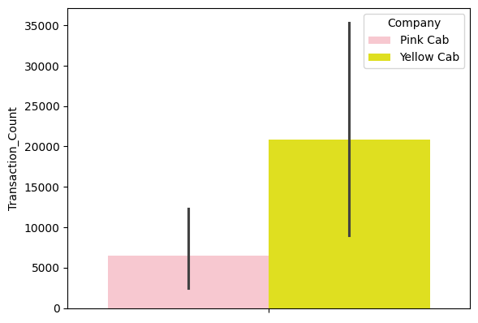
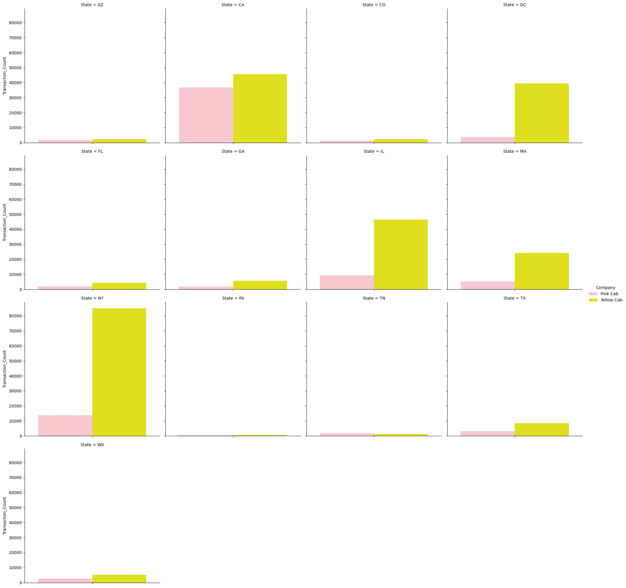
EDA
Distribution of transaction counts over all populations
Distribution of transaction counts over every state

Slide 7
EDA Summary
Table of Contents of EDA:
Hypothesis 1: The average cost of trips would be lower if there were fewer customers, as this would encourage more people to use their services.
Hypothesis 2: Payment method preference varies by cab company, with one company seeing higher usage among customers paying by a specific method.
Hypothesis 3: Companies may profit differently based on distance travelled
Hypothesis 4: Certain months show higher cab usage such as holidays such as Thanksgiving and Christmas. December will have more cab traffic as many people are flying home or out for the holidays.
Hypothesis 5: Company experiences different amount of customers based on which state they are in.
Hypothesis 6: The number of card payments will grow as we move towards a digital world.

Slide 8
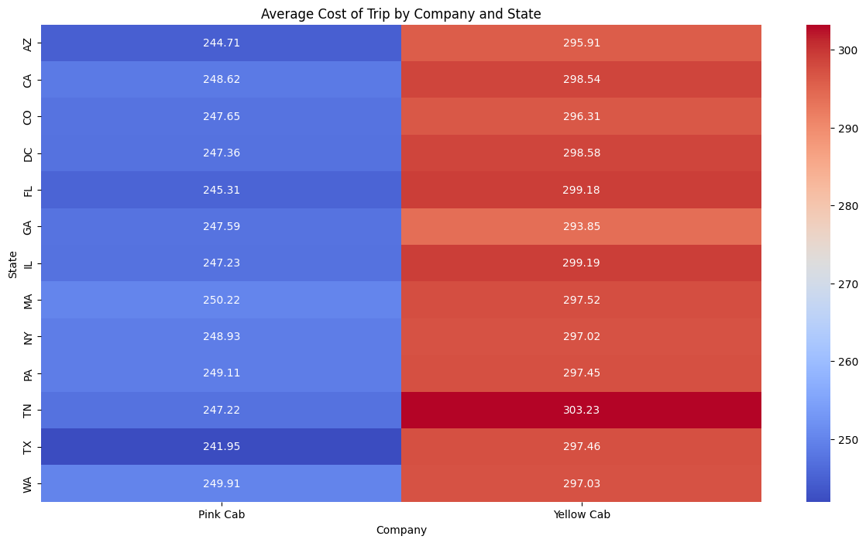
Hypothesis 1
Null Hypothesis (H₀):
The average cost of trips is not influenced by the size of the customer base, meaning that companies with fewer customers do not experience lower trip costs as a result of having fewer customers.
Alternative Hypothesis (Hₐ):
The average cost of trips decreases for companies with a smaller customer base, suggesting that having fewer customers leads to lower trip costs, which may encourage more people to use the service.

Slide 9
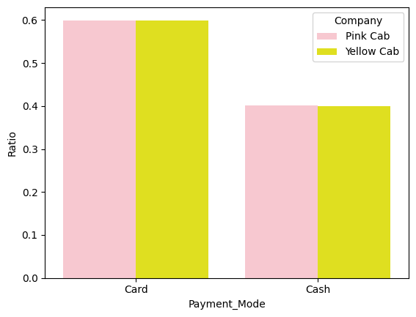
Hypothesis 2
Null Hypothesis (H₀): Payment method preference does not vary by cab company. The proportion of customers using each payment method is the same across all cab companies.
Alternative Hypothesis (Hₐ): Payment method preference varies by cab company, with at least one cab company showing a higher usage of a specific payment method compared to others.

Slide 10
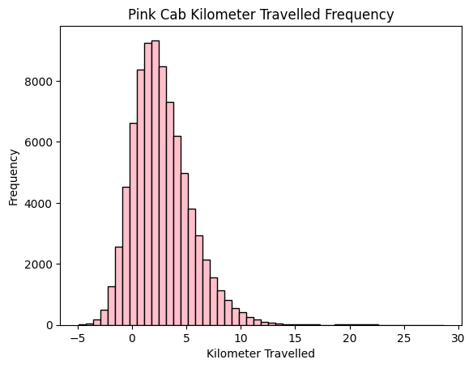
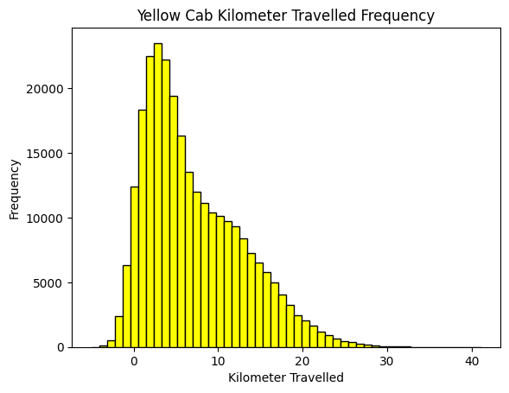
Hypothesis 3

Slide 11
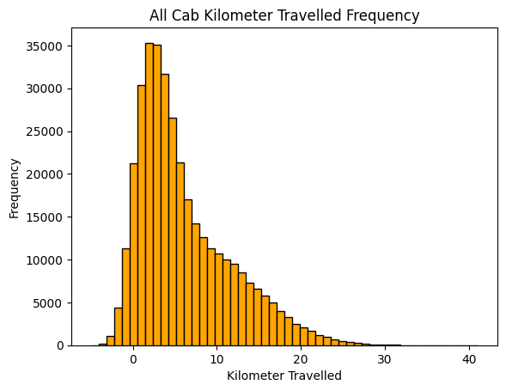
Hypothesis 3
Null Hypothesis (H₀): The profit earned by companies does not vary based on the distance traveled.
Alternative Hypothesis (Hₐ): The profit earned by companies varies based on the distance traveled.

Slide 12
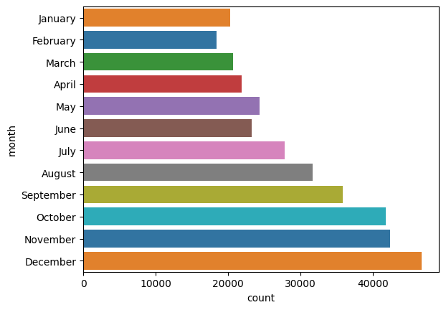
Hypothesis 4
Null Hypothesis (H₀): Cab usage does not vary significantly between months, including December.
Alternative Hypothesis (Hₐ): Cab usage is significantly higher in December compared to other months, particularly due to holidays like Thanksgiving and Christmas.

Slide 13
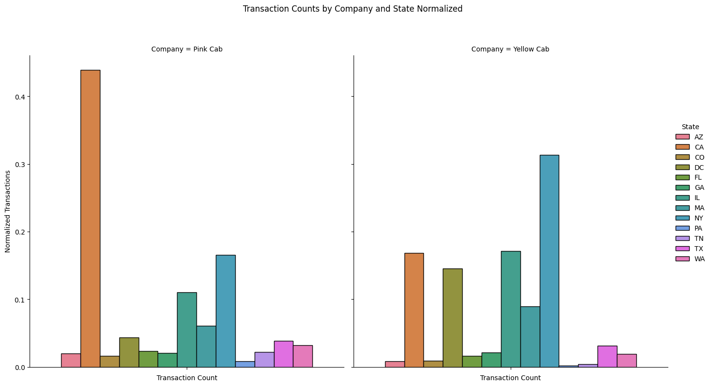
Hypothesis 5
Null Hypothesis (H₀): There is no difference in the number of customers the company experiences across different states.
Alternative Hypothesis (Hₐ):
There is a difference in the number of customers the company experiences depending on the state.

Slide 14
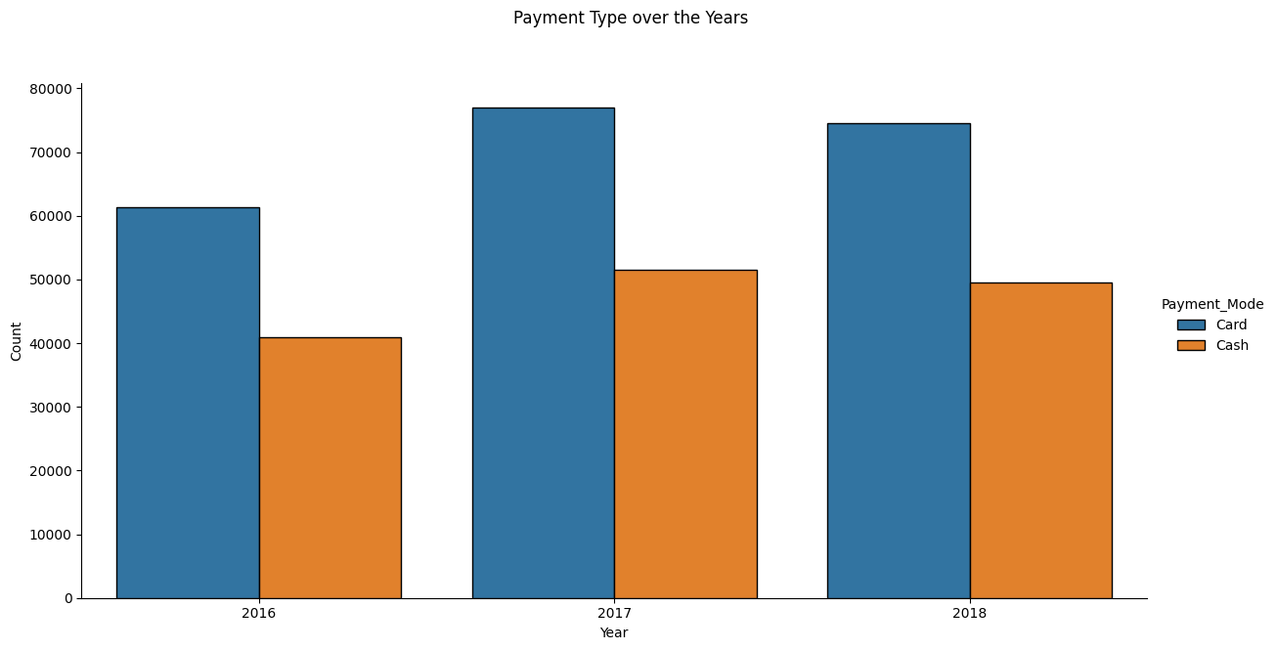
Hypothesis 6
Null Hypothesis (H₀): There is no difference in the number of customers the company experiences across different states.
Alternative Hypothesis (Hₐ): The number of customers the company experiences varies depending on the state they are in.

Slide 15
EDA Summary
Average Cost of Trip by Company and State
The null hypothesis is rejected, as the data supports the alternative hypothesis. This suggests that companies with a smaller loyal customer base need to lower prices in order to attract more customers before considering a price increase.
Payment Mode Ratio by Company
The null hypothesis is not rejected, as the data supports the null hypothesis. This suggests that both companies are equally accommodating for different types of payment alternatives.
Optimal Profit per Kilometer Traveled
The null hypothesis is not rejected, as the data supports it. When comparing the profit per kilometer graphs for both companies, as well as the combined graph, it becomes clear that the optimal profit per kilometer is achieved at the same driving distance for both companies.
Frequency of customers through the months
The null hypothesis is not rejected, as the data supports it. Upon comparing the profit per kilometer graphs for both companies, along with the combined graph, it is evident that the optimal profit per kilometer occurs at the same driving distance for both companies.

Slide 16
EDA Summary
5. Transaction Counts by Company and State Normalized
The null hypothesis is not rejected, as the data supports it. When comparing the profit per kilometer graphs for both companies, as well as the combined graph, it is clear that the optimal profit per kilometer is achieved at the same driving distance for both companies.
Pink Cab has a larger customer base in California, while Yellow Cab's customer base is predominantly in New York.
6. Payment Types over the Years
The null hypothesis is not rejected, as the data supports it. This suggests that there may not be a clear linear trend of customers switching to digital payment methods, possibly due to the limited time period. Further research with an extended time frame is needed before drawing a definitive conclusion.

Slide 17
Recommendations
Avoid increasing prices in an attempt to grow the loyal customer base, as this may deter potential users. Prices should only be increased once a sustainable level of profit has been ensured.
Although both companies have a similar balance of card and cash users, it is important to accommodate other payment methods, such as Apple Pay and Samsung Pay, to ensure accessibility for all customers.
Most profits occur in shorter drives, which helps lessen time spent with customers as well as profiting more. However, it is interesting to see how companies can look to improve their profits in longer drives.
Companies should look to find ways to improve customers in those periods of time.
While each company is well established in certain states, they should consider expanding into new regions to increase their presence in areas where they are less known.
We should analyze a longer time period to determine if there is a trend toward increased card usage, which would indicate a need to accommodate additional payment options. As virtual currency becomes more prevalent, it's important to assess whether cab companies are following this trend.

Slide 18
Thank You

